Slide 1

Web Apps and Spring Framework

Slide 2
Context
What is Spring Framework
Advantages of using Spring Framework
Key features of Spring Framework
Spring Modules
Dependency Injection and Inversion
Aspect Oriented Programming

Slide 3
What is Spring Framework?
The Spring Framework is a Java platform that provides comprehensive infrastructure support for developing Java applications.
Spring handles the infrastructure so you can focus on your application.
Spring enables you to build applications from "plain old Java objects" (POJOs) and to apply enterprise services non-invasively
to POJOs. This capability applies to the Java SE programming model and to full and partial Java EE.
Examples of how you, as an application developer, can benefit from the Spring platform:
Make a Java method execute in a database transaction without having to deal with transaction APIs.
Make a local Java method an HTTP endpoint without having to deal with the Servlet API.
Make a local Java method a message handler without having to deal with the JMS API.
Make a local Java method a management operation without having to deal with the JMX API.

Slide 4
Advantages of Using Spring Framework
Open source
Lightweight and fast
Loose coupling thanks to Dependency Injection
Automatic Transaction Management
AOP support
Supports Both XML and Annotation Based Configuration
Modules that make our life easier like Spring Security
21

Slide 5
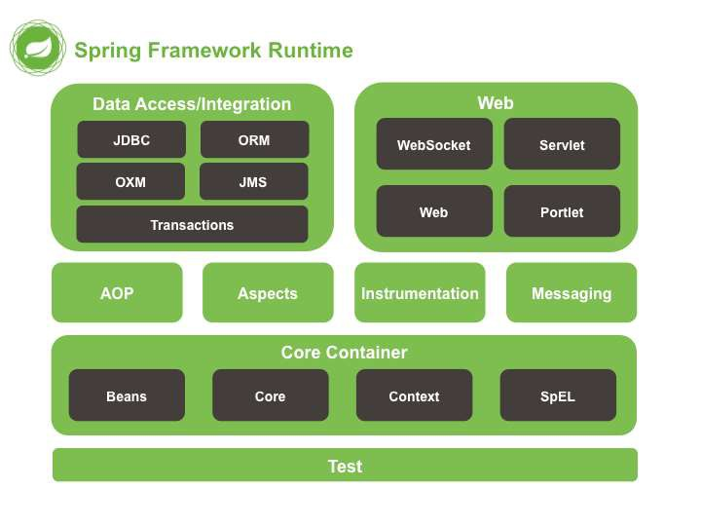
Spring
Modules
•
The Spring Framework consists of
features organized into about 20 modules.
•
These modules are grouped into Core Container, Data Access / Integration, Web, AOP (Aspect Oriented Programming), Instrumentation, and Test.
Overview of the Spring Framework
18

Slide 6
Spring Modules
Spring Projects
Spring
Spring
Spring
Spring
Spring
Core
Data & Integration
AOP
Security & OAuth
Cloud
AMQP
Web & Web Flow
Hateoas
Batch
Spring
Spring
Spring
Spring
20

Slide 7
Dependency Injection
Introduction to Concept
The technology that defines Spring (Heart of Spring).
Dependency Injection helps us to keep our classes as independent possible.
Increase reuse by applying
Easy testing low coupling
More understandable

Slide 8
Dependency Injection
Introduction to Concept
An injection is the passing of a dependency (a service) to a dependent object (a client). Passing the service to the client, rather than allowing a client to build or find the service, is the fundamental requirement of the pattern.
“Dependency injection is a pattern where the container passes objects by name to other objects, via either constructors, properties, or factory methods.”

Slide 9
Dependency Injection
Relationship between DI and Inversion of Control
In software engineering, inversion of control (IoC) describes a design in which custom- written portions of a computer program receive the flow of control from a generic, reusable library.
The Inversion of Control (IoC) is a general concept, and it can be expressed in many ways and dependency Injection is merely one concrete example of Inversion of Control.

Slide 10
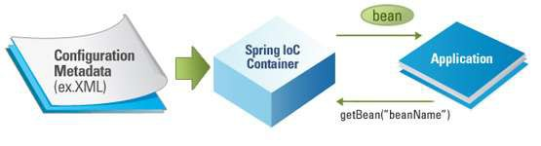
Dependency Injection
IoC Container
•
The Spring container (IoC Container) is at the core of the Spring
Framework.
•
The container will create the objects, wire them together, configure
them, and manage their complete lifecycle from creation till destruction.
7

Slide 11
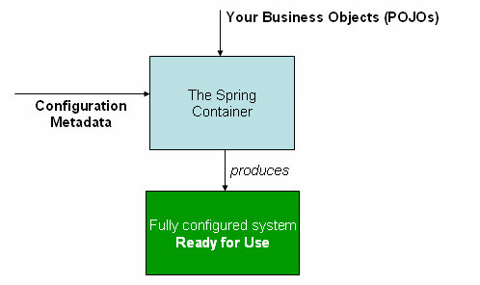
Dependency Injection
IoC Container
•
The container gets its instructions on
what objects to instantiate, configure,
and assemble by reading configuration
metadata provided.
•
The configuration metadata can be represented either by:
•
•
•
XML
Java annotations
Java code
8

Slide 12
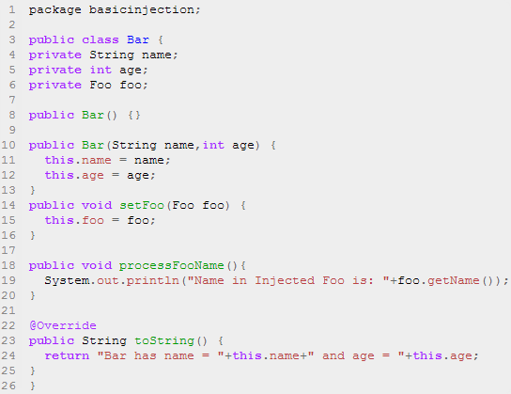
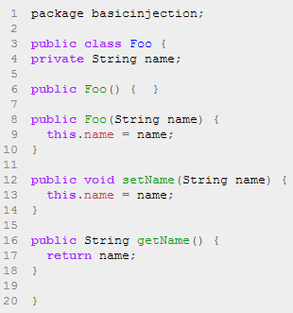
Dependency Injection
Code Example
To instantiate the above classes, one way is to do the usual new operator like new Foo() or new Bar() OR we can use the Spring dependency injection to instantiate these classes and set the properties accordingly.
9

Slide 13
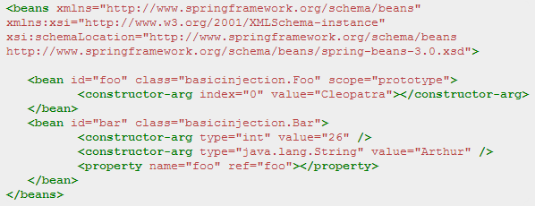
Dependency Injection
Code Example
Foo f = new Foo("Cleopatra");
Bar b = new Bar("Arthur",26);
b.setFoo(f);
10

Slide 14
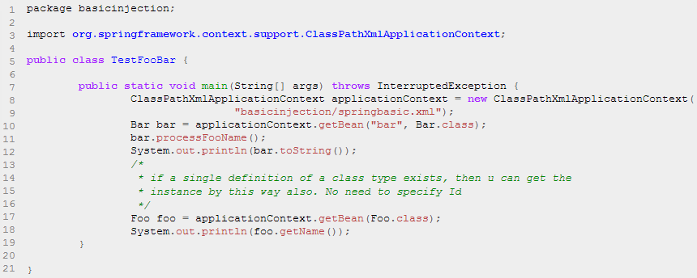
Dependency Injection
Code Example
Spring's ClassPathXmlApplicationContext is the commonly used object that hold the information of all the beans that it instantiates.
11

Slide 15
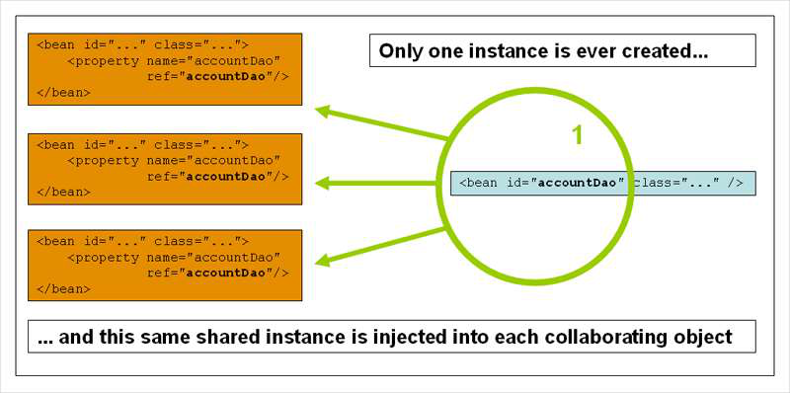
Dependency Injection
Bean Scopes
Scope | Description
Singleton | This scopes the bean definition to a single instance per Spring IoC container (default).
Prototype | This scopes a single bean definition to have any number of object instances.
Request | This scopes a bean definition to an HTTP request. Only valid in the context of a web-aware Spring ApplicationContext.
Session | This scopes a bean definition to an HTTP session. Only valid in the context of a web-aware Spring ApplicationContext.
Global-Session | This scopes a bean definition to a global HTTP session. Only valid in the context of a web-aware Spring ApplicationContext.
12

Slide 16
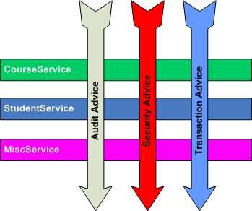
Aspect Oriented Programming (AOP)
Introduction to Concept
AOP entails breaking down program logic into distinct parts called concerns.
The functions that span multiple points of an application are called cross-cutting concerns and these cross-cutting concerns are conceptually separate from the application's business logic.
AOP is like triggers in programming languages such as Perl, .NET, Java and others.
Examples of cross-cutting concerns:
Logging
Security
Transaction
Caching
13

Slide 17
Aspect Oriented Programming (AOP)
Spring AOP
Spring AOP module provides interceptors to intercept an application, for example, when a method is executed, you can add extra functionality before or after the method execution.
Spring AOP's approach to AOP differs from that of most other AOP frameworks. The aim is to provide a close integration between AOP implementation and Spring IoC, not to provide the most complete AOP implementation.
Spring Framework's AOP functionality is normally used in conjunction with the Spring IoC container. Aspects are configured using normal bean definition syntax.
14

Slide 18
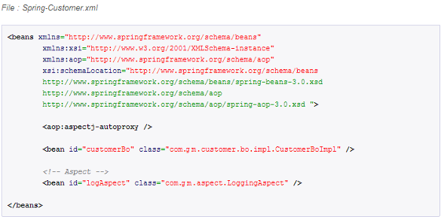
Aspect Oriented
Programming
(AOP)
Code
Example
15

Slide 19
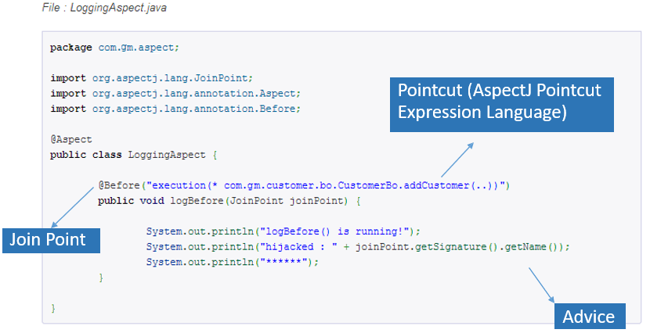
Aspect Oriented
Programming
(AOP)
Code
Example
•
•
@Before – Run before the method execution
@After – Run after the method returned a result
@AfterReturning – Run after the method returned a result, intercept the returned result as well.
@Around – Run around the method execution, combine all three advices above.
@AfterThrowing – Run after the method throws an exception
Pointcut (AspectJ Pointcut
Expression Language)
•
•
•
16

Slide 20
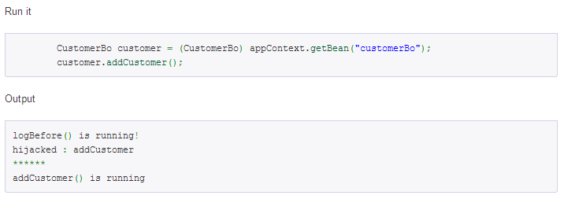
Aspect Oriented
Programming
(AOP)
Code
Example
17

Slide 21

Context
HTTP Servlet
Web Application Overview
What is Spring MVC?
MVC Architecture
Request Processing Workflow in Spring MVC
Spring Web Application Context
Spring MVC Configuration
Important Annotations
Summary

Slide 22
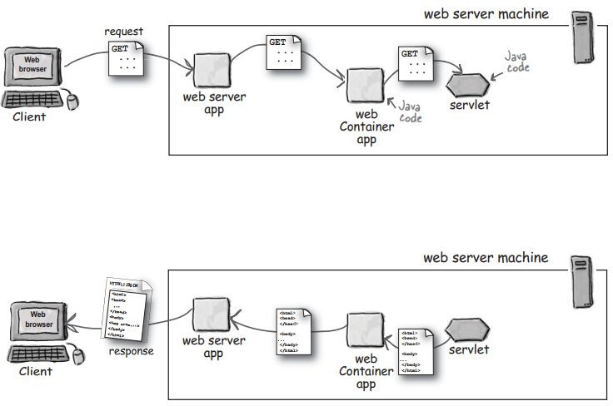
HTTP Servlets
Are Java classes that run on Web Servers to dynamically process HTTP requests and construct HTTP responses.
Deployed inside a Servlet Container which run on a Web Server.
Tomcat is a popular Servlet Container.

Slide 23
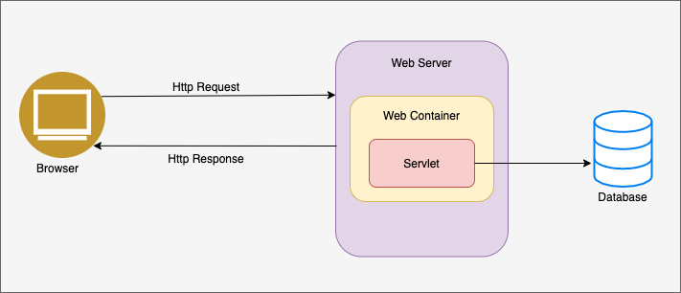
Servlets Architecture
Servlets act as a middle layer between a Web browser and databases or applications on the Web Server.
The following diagram shows the position of Servlets in a Web Application

Slide 24
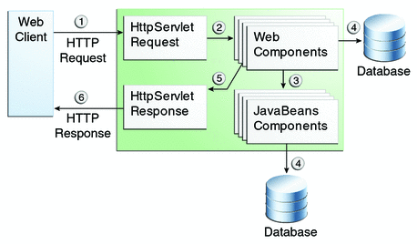
Web Application Overview
A Web application contains an application's resources, such as servlets, JavaServer Pages (JSPs), JSP tag libraries, and any static resources such as HTML pages and image files. A Web application can also define links to outside resources such as Enterprise JavaBeans (EJBs). We can develop web application using Spring MVC module of spring framework.

Slide 25
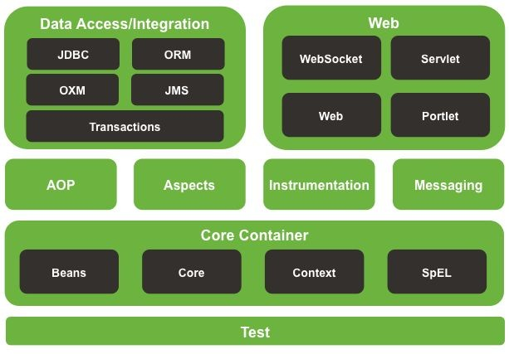
What is Spring MVC?
Modules of Spring Framework on the Web layer:
Web module provides basic web-oriented integration features and the initialization of the IoC container using servlet listeners and a web application context.
Servlet module contains Spring MVC implementation for web applications.

Slide 26
What is Spring MVC ?
A web framework built on the Servlet API.
Provides Model-View-Controller (MVC) architecture and ready components that can be used to develop flexible and loosely coupled web applications.
Request-driven, designed around a central Servlet that dispatches requests to controllers - the DispatcherServlet.

Slide 27
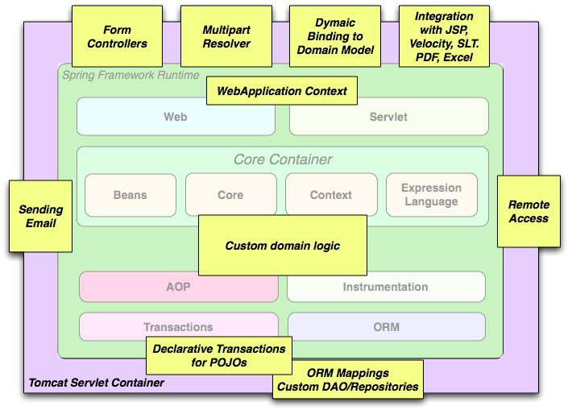
Spring Web
The building blocks described previously make Spring a logical choice in many scenarios, from applets to full-fledged enterprise applications that use Spring's transaction management functionality and web framework integration.
Typical full-fledged Spring web application
19

Slide 28
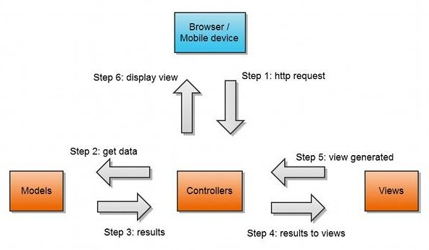
MVC (Model-View-Controller)
An architectural pattern commonly used for developing user interfaces.
An application is divided into 3 interconnected parts:
Model - Responsible for managing data of the application.
View - Responsible for displaying the model data to user.
Controller - Responsible for processing user requests and building an appropriate model and passes it to the view for rendering.

Slide 29
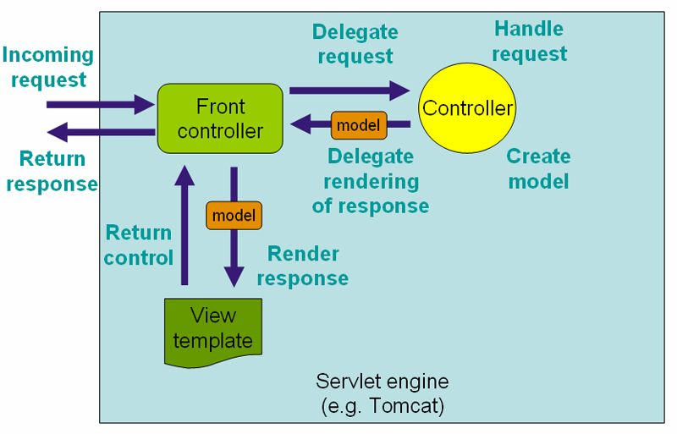
Request Processing Workflow (High Level)
The request processing workflow in Spring Web MVC (high level)

Slide 30
DispatcherServlet
Spring MVC is designed around a central servlet named DispatcherServlet.
DispatcherServlet acts as a central entry point to the Spring MVC application.
Every request is handled by DispatcherServlet.
DispatcherServlet is an expression of the Front Controller pattern.
The request processing workflow in Spring Web MVC (high level)

Slide 31
Controllers
The Front Controller’s job is to determine a suitable handler capable of performing the actual processing.
Handlers are Spring MVC Controllers.
The selected Controller interacts with the service layer; the relevant data are collected in a model.
When the Controller has finished processing, the Front Controller determines which view to render.
The request processing workflow in Spring Web MVC (high level)

Slide 32
View
When the Controller has finished processing, the Front Controller determines which view to render.
The Front Controller passes the model to the view which is finally which is finally rendered on the browser.
The request processing workflow in Spring Web MVC (high level)

Slide 33
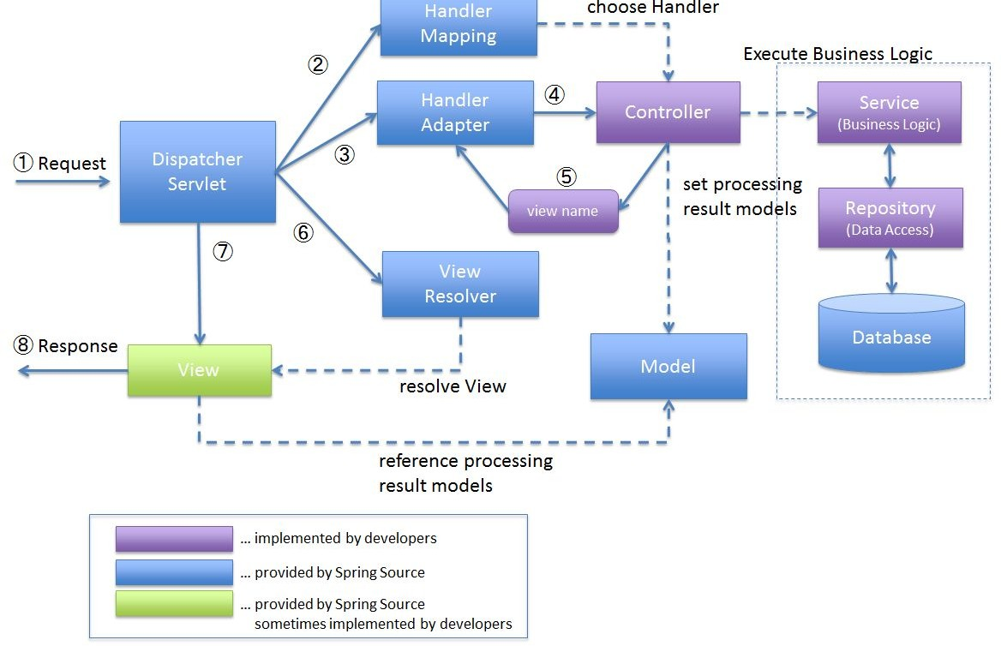
Request Processing Workflow (Details Level)
DispatcherServlet receives the request.
DispatcherServlet dispatches the task of selecting an appropriate controller to HandlerMapping. HandlerMapping selects the Controller which is mapped to the incoming request URL and returns the (selected Handler) and Controller to DispatcherServlet.
DispatcherServlet dispatches the task of executing of business logic of Controller to HandlerAdapter.
HandlerAdapter calls the business logic process of Controller.
Controller executes the business logic, sets the processing result in Model and returns the logical name of view to HandlerAdapter.
DispatcherServlet dispatches the task of resolving the View corresponding to the View name to ViewResolver. ViewResolver returns the View mapped to View name.
DispatcherServlet dispatches the rendering process to returned View.
View renders Model data and returns the response.

Slide 34
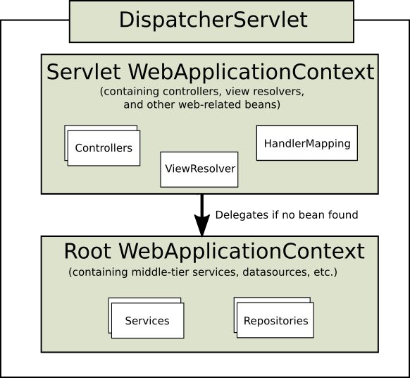
Web Application Context
DispatcherServlet expects a WebApplicationContext, an extension of a plain ApplicationContext, for its own configuration.
WebApplicationContext has a link to the
ServletContext and Servlet it is associated with.
The root WebApplicationContext typically contains infrastructure beans such as data repositories and business services which are inherited and could be overridden in the Servlet WebApplicationContext.
Servlet WebApplicationContext contains web-related beans: such as controllers, handler mappings,...

Slide 35
Important annotations
Some important annotations which are used in a Spring MVC application.
@Controller and @RestController
@RequestMapping
@GetMapping, @PostMapping, @PutMapping and @DeleteMapping
@RequestParam, @PathVariable
@RequestBody
@ResponseBody

Slide 36
GM Employee Management System – DEMO Application
This application is built with Spring Boot MVC, JPA, Thymeleaf and having below functionalities
User can Sign Up
User can login
User can view the list of Users
User can logout

Slide 37
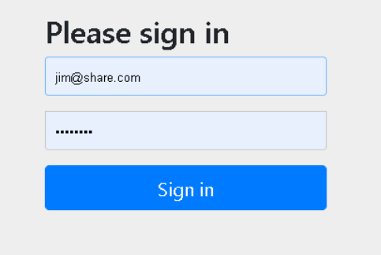

Slide 38
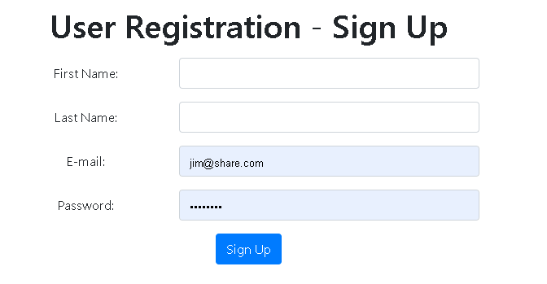

Slide 39
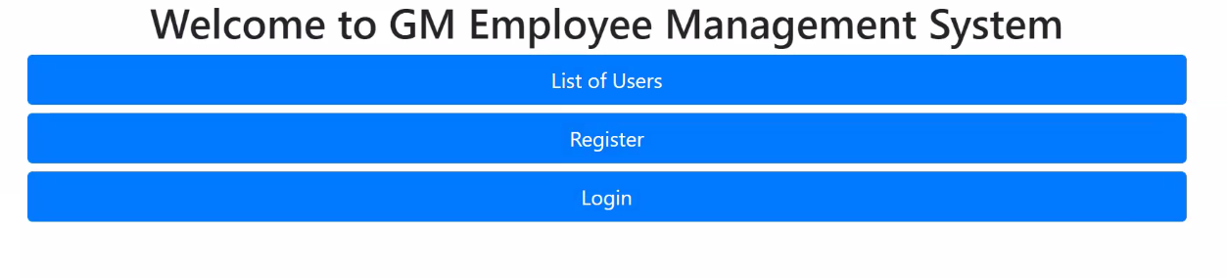

Slide 40
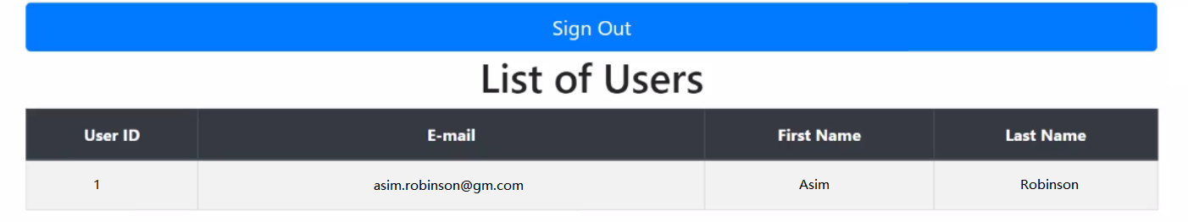

Slide 41
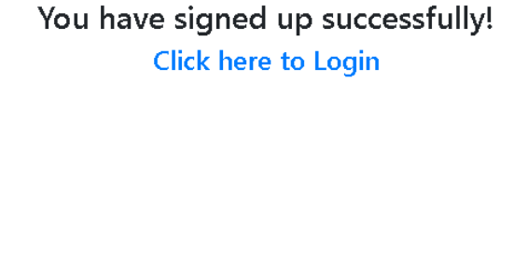

Slide 42
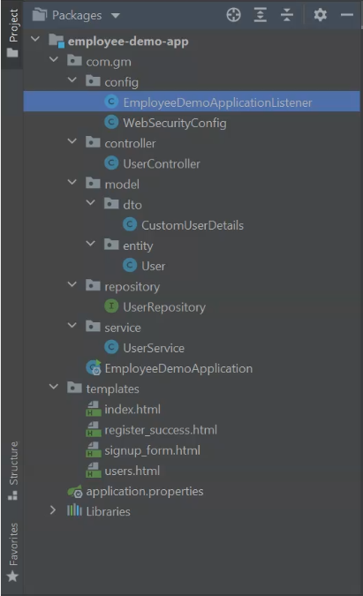

Slide 43
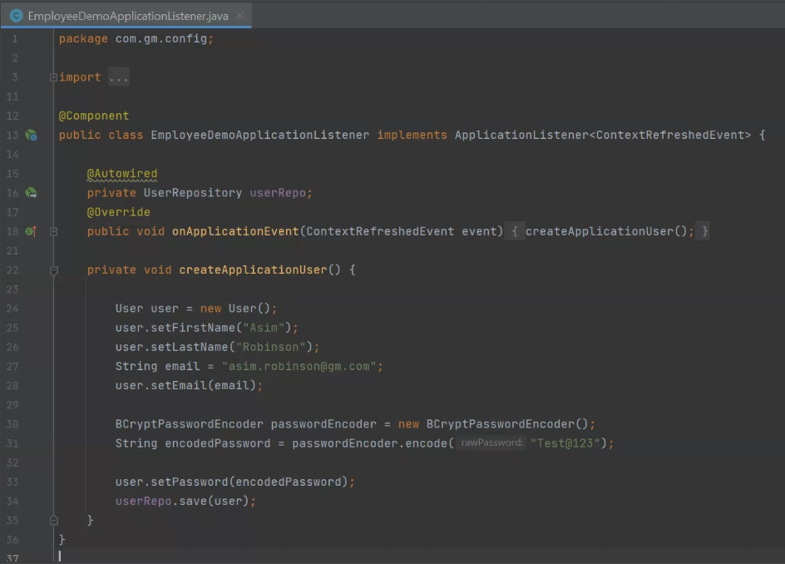

Slide 44
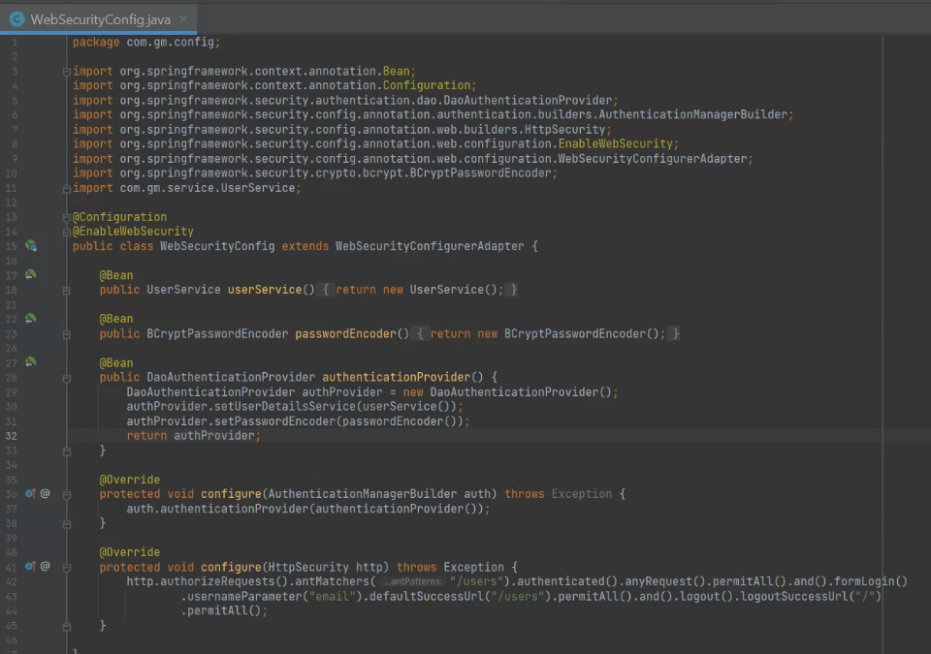

Slide 45
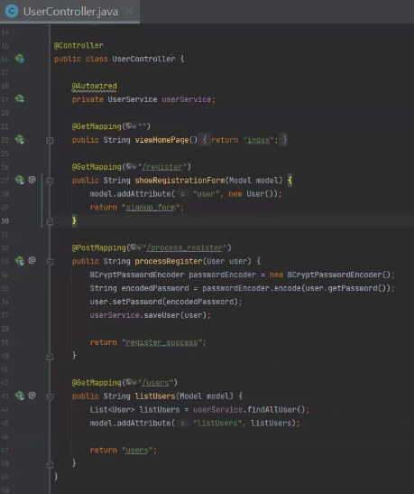

Slide 46
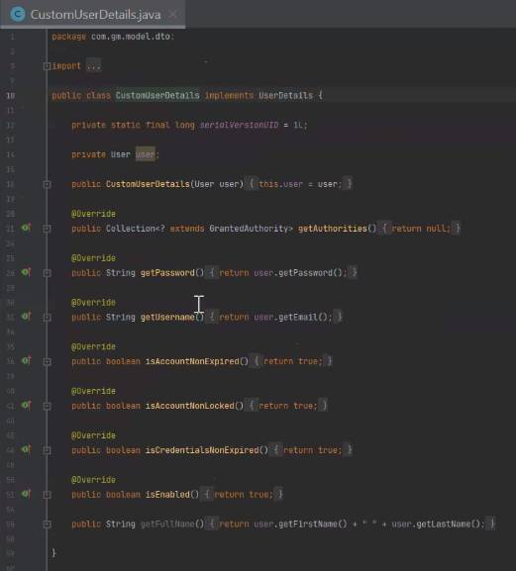

Slide 47
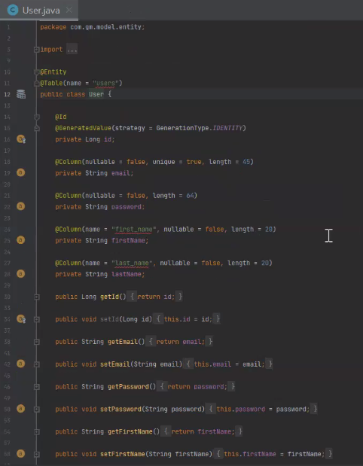

Slide 48
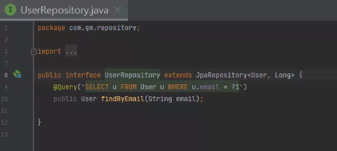

Slide 49
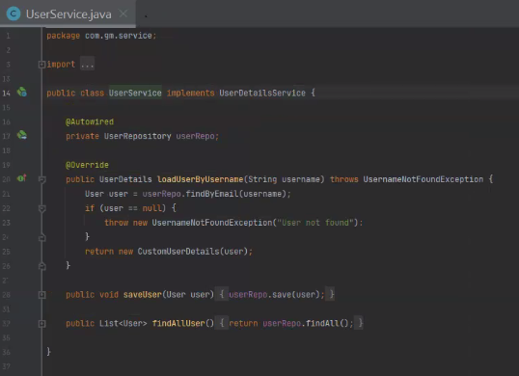

Slide 50
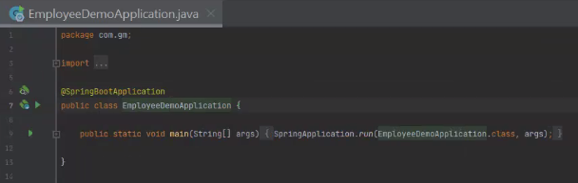

Slide 51
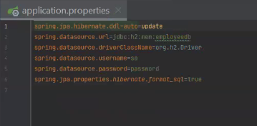

Slide 52
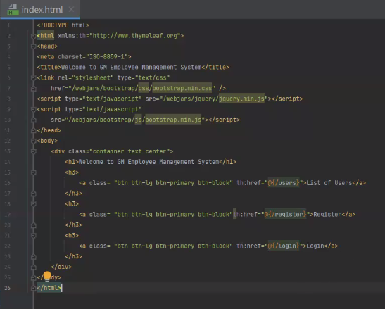

Slide 53
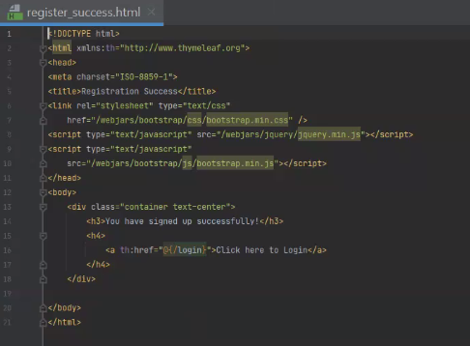

Slide 54
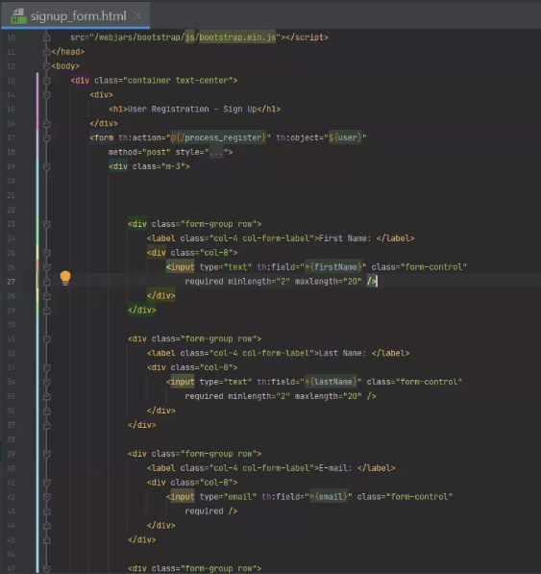

Slide 55
